Slide 1
Customer Subscription and Churn Analysis
Andreas Wong
15/09/2026

Slide 2
Project Brief
The leadership team at a (fictional) subscription company, NovaStream, is concerned with customer churn. They want to know who is leaving, why, and what the business can do about it. They have given their data analyst (me) an export of the customer base across several tables.
The objectives are: Preparing and cleaning the data, modelling it by building relationships into a star schema, exploring the data and building visuals to analyse what drives churn, and then communicating my findings, insights, and give actionable recommendations.
Key questions:
What is the overall churn rate?
Does contract type relate to churn?
Do Auto-renew, plan or price relate to churn?
Do engagement signals separate customers who churn from those who stay?
Which factors matter most, and which look like they matter but don’t?

Slide 3
Dataset overview
Source of the data- A synthetic, teaching dataset. It is not real customer data, but behaves like real data
There are five tables: Subscriptions (Fact table), Customers, PaymentMethods, Plans, and Regions (Dimension tables)
After cleaning, Subscriptions contains 2000 records, as does Customers.

Slide 4
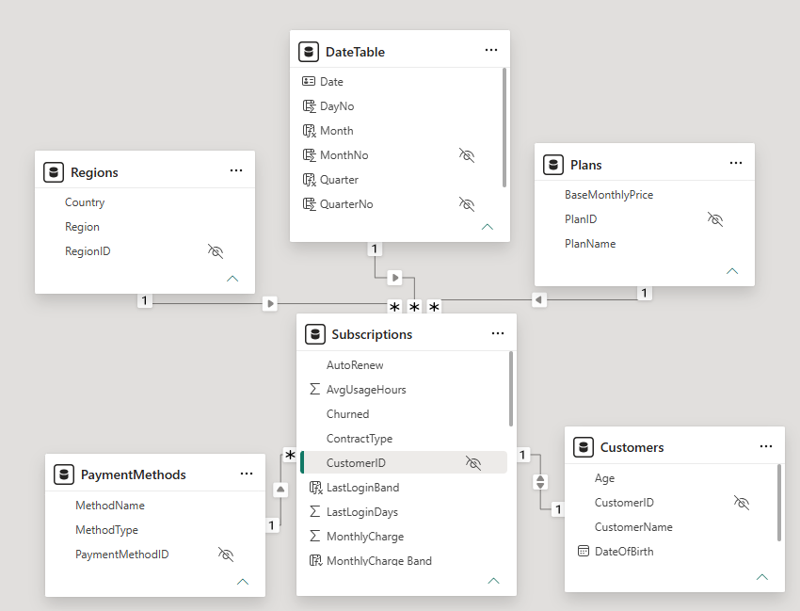
Dataset Structure
Key variables by type:
The target column to be analysed is Churned. (This is categorical)
Categorical
Region, PlanName, CustomerName, ContractType, Auto-Renew
Numerical
LastLoginDays, MontlyCharge,AvgUsageHours, Support Tickets, TenureMonths
Date
SignupDate
Keys / IDs
PlanID, CustomerID, RegionID, PaymentMethodID (Key columns all hidden, IDs not summarised)

Slide 5
Identified Problems in Dataset
Duplicate Customer IDs in Subscriptions and Customers tables.
Some orphan foreign keys. For example, a region ID of 7 in the fact table when no such region ID exists in the Regions Dimension.
Some categories are inconsistent, and there are outlier and null values in some columns too. Some columns are the wrong data type, like Monthly charge.

Slide 6
Data Cleaning Process
To handle the duplicate customer IDs in both Subscriptions and Customers, I used ‘remove duplicates’ to handle them, and each table ended up with 2000 rows.
With regards to the null values in the Subscriptions table, including the foreign keys RegionID and PaymentMethodID, I chose to leave them as null. I checked the original source data and the values were null there, meaning the original value (if it ever existed) cannot be found. So I decided to (I did explore an alternative method which involved creating an “Unknown” dimension member and assigning it an ID of -1 but this wasn’t in the scope of what we covered during bootcamps). With regards to the orphan foreign key values, I changed these to “null”. For AvgUsageHours and LastLoginDays, I did not want to assume the null values were supposed to be 0, which is my reasoning for leaving them as nulls as opposed to replacing them with 0. (If I was supposed to assume the null values represented 0, I will change this upon feedback).
With the outliers of Tenure = 999 and and Monthly Charge = 9999, I changed these to “null”, they are obviously not actual outliers and probably just a data entry error, so I did not replace the outliers with something like the average Tenure and average Monthly Charge.
Next, to deal with MonthlyCharge being text data type, I first got rid of the dollar signs using ‘replace values’. After that, I changed the data type of the column to fixed decimal.
Looking at inconsistent values for ContractType, AutoRenew and Churned, I used ‘Replace Values’ to ensure consistency. (Monthly/Annual, Yes/No, and Yes/No respectively).

Slide 7
Data Cleaning (Continued)
In the Customers table, I did the following cleaning:
Removed duplicate customer IDs
The missing DOBs were missing in the original data, so again, I had to leave these null because there would be no way to know what the actual DOBs are. There are 26 null values here.
Sorted the inconsistent gender category, so they are now either Male or Female as the only two options
Removed the trailing spaces in CustomerName.
With regards to all the cleaning steps (or lack of) for the values I left as null, I decided to do this because we had no information on why some of the data is missing or wrong so I did not feel comfortable replacing them with a non-null value. Dealing with null values could cause issues when creating visualisations but these can be solved with visual filters.
In the subscriptions table, there are 44 null values for RegionID, 5 in PlanID, and 50 for PaymentMethodID. There are 2 nulls in MonthlyCharge, 3 in Tenure, 70 for average usage hours, and 40 for LastLogin.

Slide 8
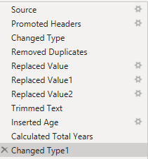
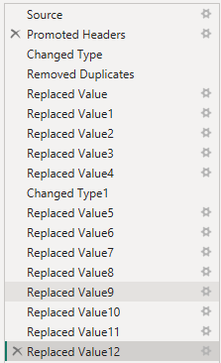
Data Cleaning steps in PQ
Customers table
Subscriptions table

Slide 9
Data Transformation
To create the Date Table I used:
DateTable = CALENDAR(MIN(summit_orders_combined[Order Date]),MAX(summit_orders_combined[Order Date])).
I used PowerQuery to create an age column from Date of birth. This would be important because it allows us to explore whether age could be a factor affecting churn.
I also created bands for tenure and usage, in order to help idenfify patterns. E.g. Rather than looking at Churn for every single possible value of tenure and usage, you can split them into High/Medium/Low bands which makes it much easier to interpret.
Values for tenure range from 1 to 72 months, which works out nicely to six years, so I split tenure into 6 bands, each band representing 12 months (aka a year).
Values for usage range from 0 to 93, and when looking at the distribution of avgusagehours, there was a high spike in customers with a value of 0, so I actually had a separate band for the value 0 (No usage), with the other bands being 1-20 (low), 21-40 (moderate) , 41-60 (high), and 61+ (very high). There were only two customers with average usage of over 80, so I felt it was best to have the upper band as 61+ rather than include bands for 61-80 and 81+.
I know that tenure and usage contain null values, so I also have a band called ‘missing’ for when the value is null.
I also created bands for last login, and the distribution showed very right skew, so I concentrated more bands in the lower values.

Slide 10
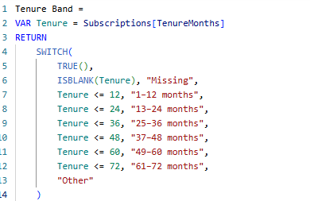
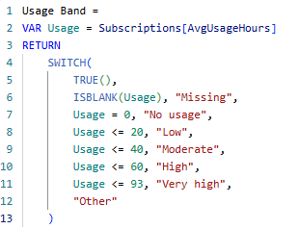
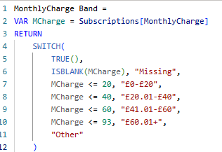
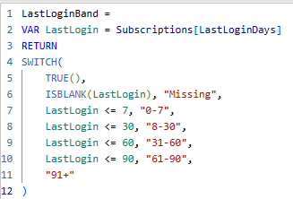
Data Transformation
Below is the DAX I used to create each band:

Slide 11


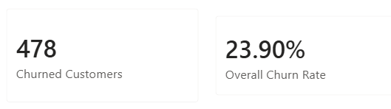
Exploratory Data Analysis
By using DISTINCTCOUNT, we get 2000 for Total Customers, which matches the 2000 rows of our subscriptions and customers tables.
I have also pasted the DAX code I used to find the number of churned customers, and the overall churn rate, which are all displayed on the left.

Slide 12
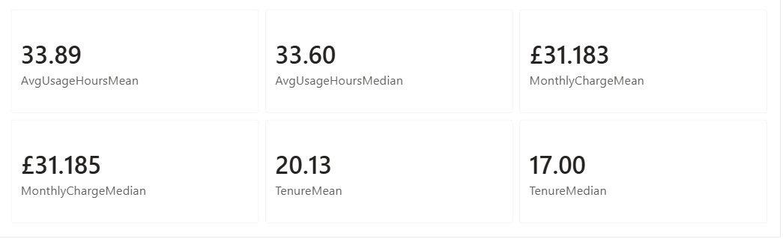
Exploratory Data Analysis (Continued)
Displayed below are the means and medians of several different variables:
The means and medians for usage and monthly charge are very close, which suggests little to no skew, whereas the median tenure is lower than the mean tenure, suggesting that the distribution might be right skewed.

Slide 13
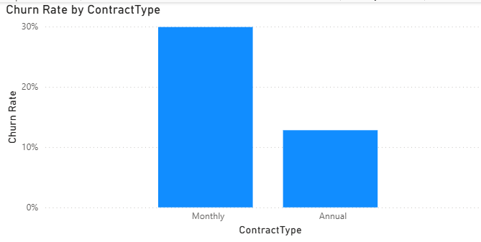
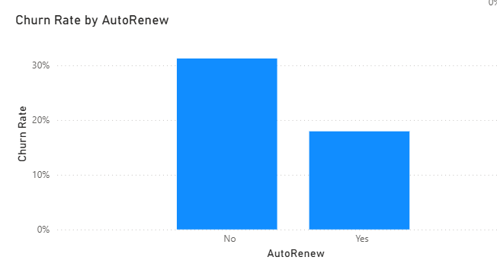
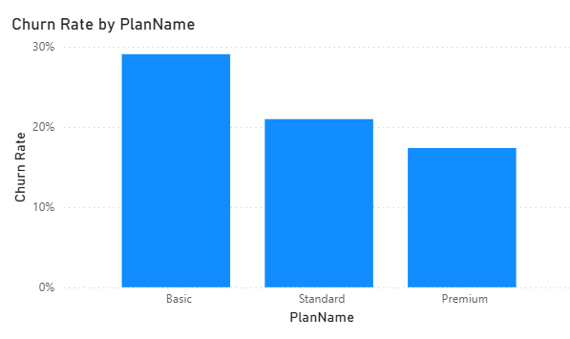
Visual Analysis (part 1)
Looking at the three column charts here, churn rate is much higher for monthly (~30%) contracts than Annual (12.8%).
Churn rate is higher for customers with auto-renew turned off (31.25% vs 17.93%).
Churn rate is highest for those on the basic plan, followed by standard, then premium (29% vs 20.97% vs 17.37%)

Slide 14
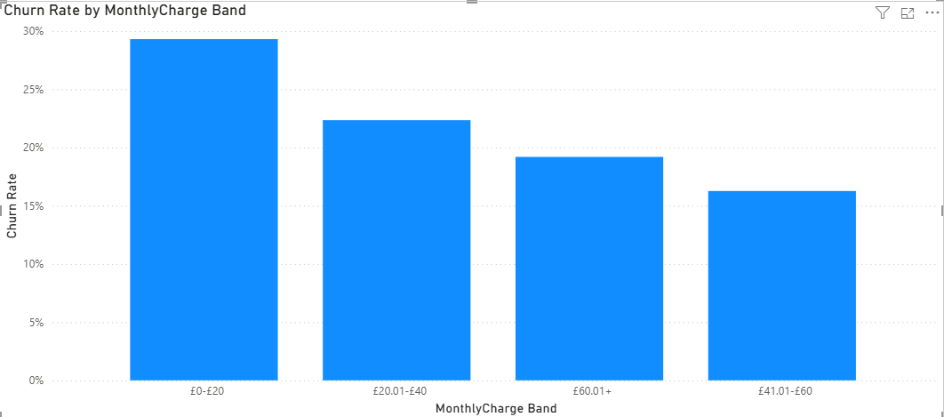
Visual Analysis (part 2)
Looking at churn rate by monthly charge, we can see the churn rate is highest for those paying between £0 and £20, with 29.31%. However, those paying over £60 actually have a higher churn rate(19.19%) than those paying between £40 and £60 (16.26%).

Slide 15
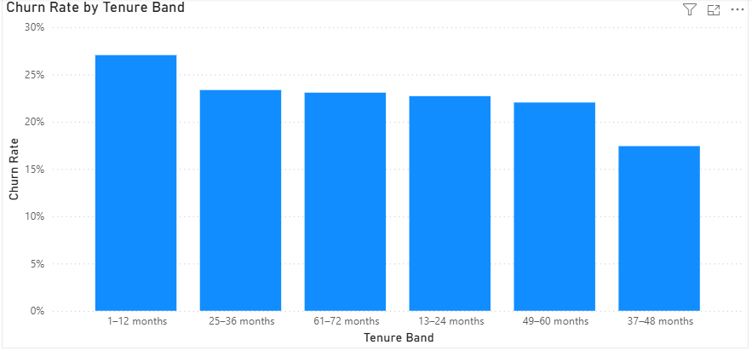
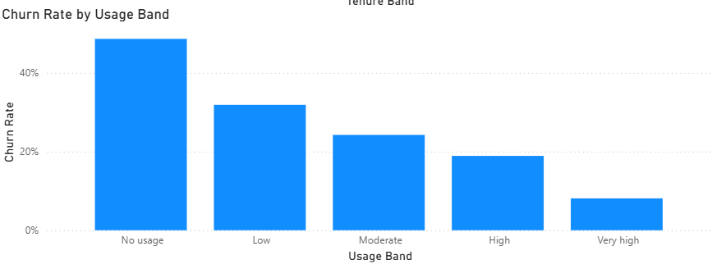
Visual Analysis (part 3)
Using the tenure and usage bands we created earlier, we were able to compare churn rate across these variables too.
Those in the 1st tenure band have the highest churn rate (27%), whereas the tenure band with the lowest churn rate is the 37-48 months (17.42%), with all other bands having a similar churn rate to each other (22-23%).
Looking at churn rate by usage band, those with no usage have the highest churn rate (48.65%), and the churn rate decreases at each further band. (ie, ‘Low’ usage next highest churn rate, ’Moderate usage next highest churn rate e.t.c)

Slide 16
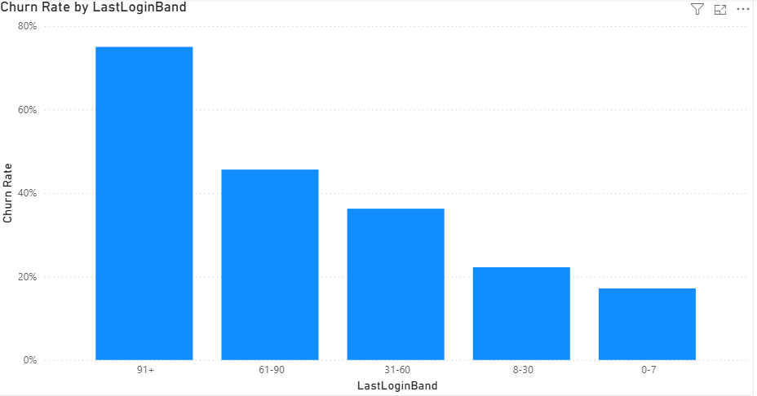
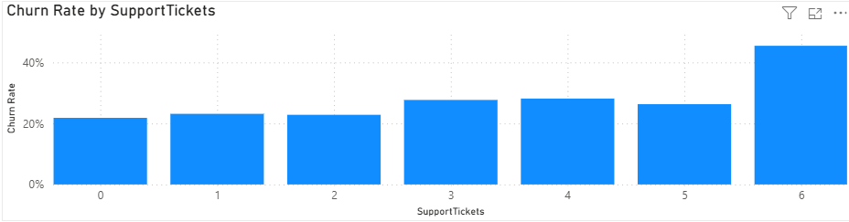
Visual Analysis (Part 4)
Looking at churn rate by Last Login, we can clearly see that the more days since last login, the greater the churn rate. The churn rate for those who hadn’t logged in over 91 days ago was 75%. However, it should be noted there were not many customers in that band, but even ignoring the 91+ band, churn rate for 61-90 was 45.61% compared to 36% for 31-60, 22.2% for 8-30, and only 17.13% for 0-7.
Churn rate for those with 6+ support tickets was 45.45% compared to 21.83% for 0 tickets. However, there is no obvious slope compared to some of the other variables we explored.

Slide 17
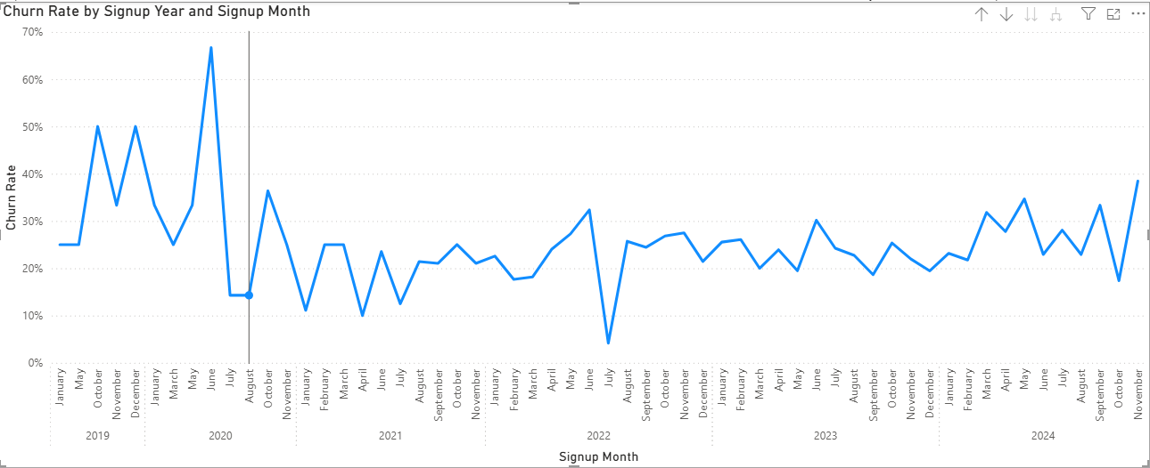
Visual Analysis (part 5)
I tried examining churn rate by signup month to see whether churn varied across different customer signup cohorts. The churn rate for those who signed up in 2019 and 2020 is higher.
However, this visual might not be that useful, since we only know the signup year, and not when the customers actually churned, and what we really want to see if there is any seasonal trend in when customers churned, which I unfortunately believe we cannot find using the current data.

Slide 18
Insights and findings
We had 5 questions to answer in this brief:
What is the overall churn rate?
Does contract type relate to churn?
Do Auto-renew, plan or price relate to churn?
Do engagement signals separate customers who churn from those who stay?
Which factors matter most, and which look like they matter but don’t?
1. The overall churn rate is 23.9%
2. Those on a monthly contract have a much higher churn rate (~30%) than those on an Annual contract (12.8%). This suggests that contract type does relate to churn.
3. Based on my insights on Visual Analysis (part 1), Auto-renew and plan seem to relate to churn, with customers with auto-renew turned off churned at a higher rate, and those on the cheaper plans had higher churn rate too. These were both ‘linear’. Based on my insight on part 2 of my visual analysis, there was a relationship between monthly charge and churn, although this one wasn’t as ‘linear’ so I would say it relates to a lesser degree than the other two variables.

Slide 19
(continued)
4. My analysis on part 3 of the Visual Analysis slides showed that tenure does not really separate customers who churn from those who don’t. There is not really a strong relationship, as although those with the shortest tenure have the highest churn rate, the band with the lowest churn rate is not the highest tenure band, and all other bands have similar churn rates to each other.
The next weakest indicator is probably the number of support tickets. Although those with 0 support tickets had the lowest churn rate, and those with the most support tickets (6) had the highest churn rate, for anywhere between 1-5 support tickets, there is not a strong relationship.
The other two engagement signals, last login and usage hours, do show much more evidence for separating those customers who churn and those who don’t. Looking at the visual Churn Rate by Usage Band, we can see churn rate decreases as a customer’s usage increases. Similarly, for last login, churn rate is higher the more days since a customer last logged in.
5. Based on findings, contract type, auto-renew, plan, usage hours, and last login matter the most when it comes to factors associated with churn.
The analysis suggests that customer activity is more strongly associated with churn than customer tenure. Usage hours and days since last login show clearer differences between churned and retained customers, while tenure shows comparatively little separation. (I expected tenure to have more of an association with churn). Subscription characteristics also appear relevant, such as contract type, auto-renewal and plan.
Thinking about it, it makes sense that tenure doesn’t have a big association with churn. While at first glance you’d think shorter tenure means higher chance of churn, we must remember tenure includes customers who are still signed up. A customer might only have signed up two months ago, hence a tenure of 2 months, and is not necessarily more likely to leave.

Slide 20
Recommendations
Firstly, considering those on monthly contracts churn at a much higher rate than those on an annual contracts, one thing the company should look at is how to incentivise those on monthly contracts to commit to an annual contract. This could be done through offering discounts on annual subscriptions, a free month, or additional benefits for the customer. Alternatively, they could consider introducing a new 6-month subscription as a middle ground.
With regards to auto-renewal (and higher churn rate for customers with it turned off), NovaStream could take measures which encourage users to turn on auto-renew. For example, clearer messaging when a customer first signs up, sending reminders before a subscription expires, or potential incentives.
Since we identified customer engagement (usage hours, days since last login), as another factor associated with churn, NovaStream can use the data it has on users to identify yet-to-churn customers who have either low usage hours, not logged in for a long time, or both. They could trial a system with inactivity triggers, and when this trigger is met, a targeted re-engagement campaign can be sent to the user, e.g. personalised recommendations, limited time offers, reminders about subscription benefits.
One area worth exploring further is Plan. We saw those on basic plan had the highest churn, so it would be worth exploring why. Does the basic plan provide sufficient value for its price? Would moving some standard features down to the basic plan help? When a customer wants to cancel their plan, is it worth asking them why they’re unsubscribing? (Many subscription-based services already do this in real life.)

Slide 21
Limitations
One of my biggest issues was with the amount of nulls in my data. In some cases, it was unavoidable for me as the data was missing from the source, and without any further information as to why the data was missing, I could not replace these null values with something else.
The only case where I could make an assumption is where usage hours and lastLoginDays were null, and assume that these were 0s, but I didn’t want to risk it, as again, I had no information on why the data was missing, so I left these as null too (a decision I detailed in my Data Cleaning slides).
These limitations mean my analysis might not be 100% accurate, as missing observations reduced the number of customers available for some analyses, affecting averages, distributions and comparisons. For example, churn by usage or churn by days since last login, does not include all 2000 customers in the data, with 70 and 40 customers missing, respectively.
In addition, the dataset is synthetic teaching data, so findings might not generalise to a real subscription service.
With more time and data, I would investigate the reasons for the missing data, and the orphaned foreign key values to give me a better idea of what I could replace those values with, rather than just leaving them/assigning them null.
Additionally, when calculating the date that a customer churned by counting the number of months since the customer’s sign-up date, it seems all customers left in December 2024, which unfortunately doesn’t give us any information about whether any seasonality of when customers churned exists. (Unsure whether this is unintentional or a limitation of the synthetic teaching data).

